Slide 1

United Way
Born Learning Academy
Session 5

Slide 2
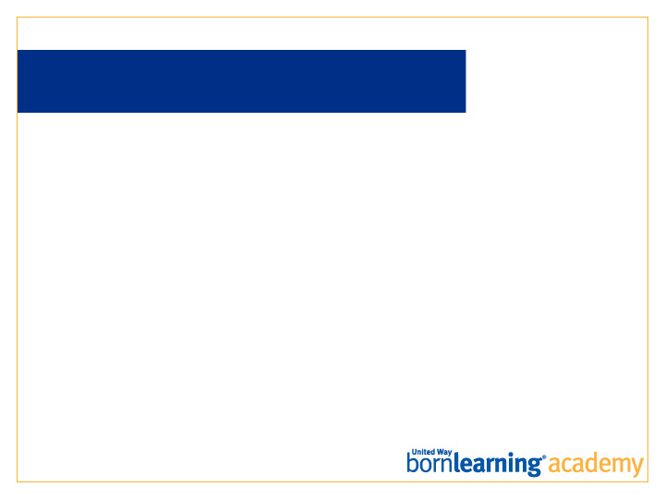
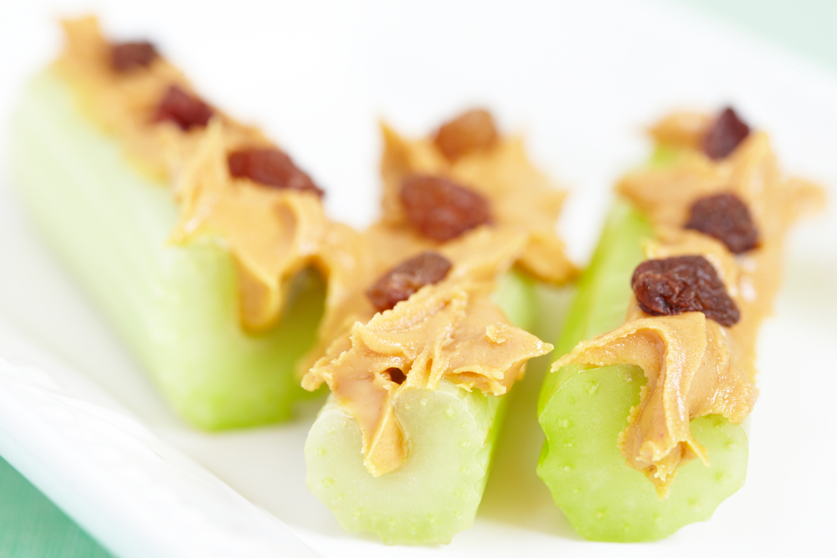
HOMEWORK RECAP
Do you have any fun, healthy snack
ideas to share?

Slide 3
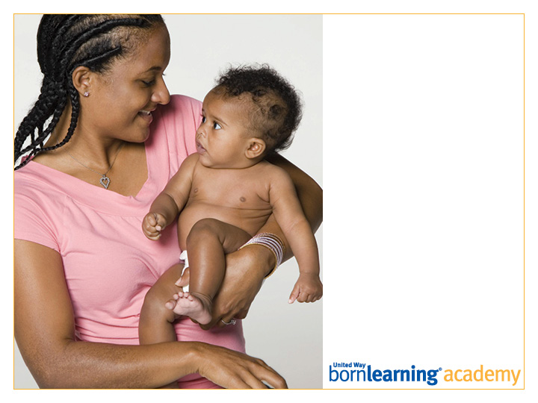
Pre-Test

Slide 4
AT THE END OF THIS SESSION, PARTICIPANTS WILL BE ABLE TO:
List two key ideas about how children learn.
Demonstrate two things that can be done at home to enhance children’s learning.

Slide 5
ABOUT BRAIN DEVELOPMENT
Rapid brain growth happens during the first few years of life.
Seventy percent of growth occurs during year one.
Ninety percent of brain is developed by year three.
Brain development functions on a “use it or lose it” principle.
Long term memory storage happens during SLEEP.

Slide 6
AGES AND STAGES
Children grow and change.
Different stages at different ages.
Different learning styles (all children are different).

Slide 7

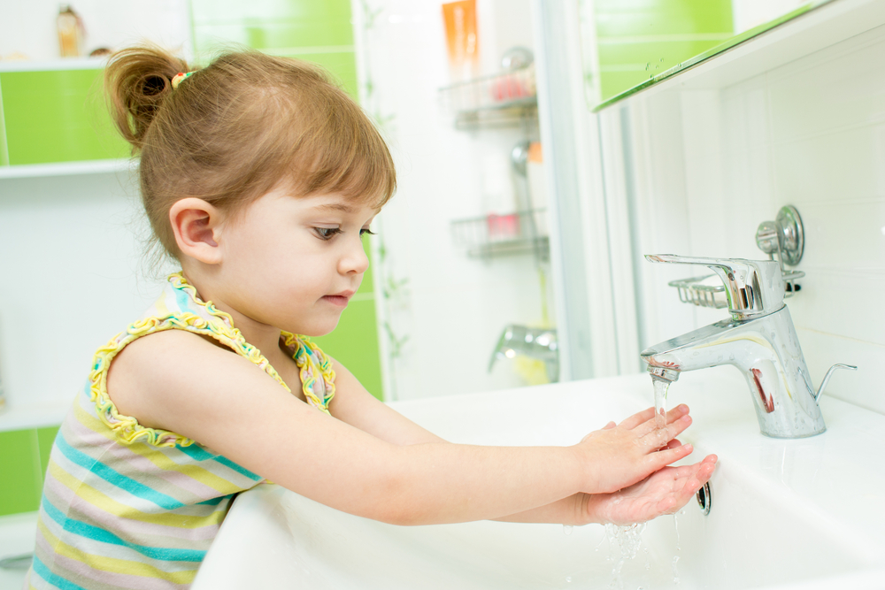

BRAINS ARE BUILT OVER TIME
Prenatal-5

Slide 8
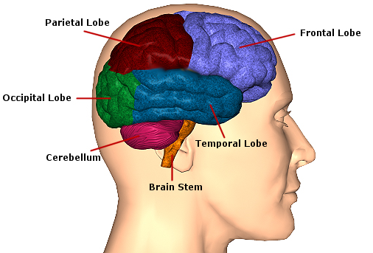
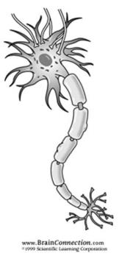
STRUCTURES OF THE BRAIN
Touching, Tasting
Thinking
Hearing, Talking
Seeing
Coordinates movement
Module 2: Neurons, Networks, & Knowledge (Version 1.0)
© 2010 University of Kentucky, HDI, KECTP

Slide 9
THE DEVELOPING BRAIN
https://www.youtube.com/watch?v=LmVWOe1ky8s

Slide 10

LIKE BUILDING A HOUSE
Build foundation.
Frame the structure.
Lay the wiring.
Add distinctive features.

Slide 11
BIG IDEAS
Brains are built over time.
The interaction of genes and early experiences literally shape the developing brain.
Center on the Developing Child, Harvard University (2007)

Slide 12
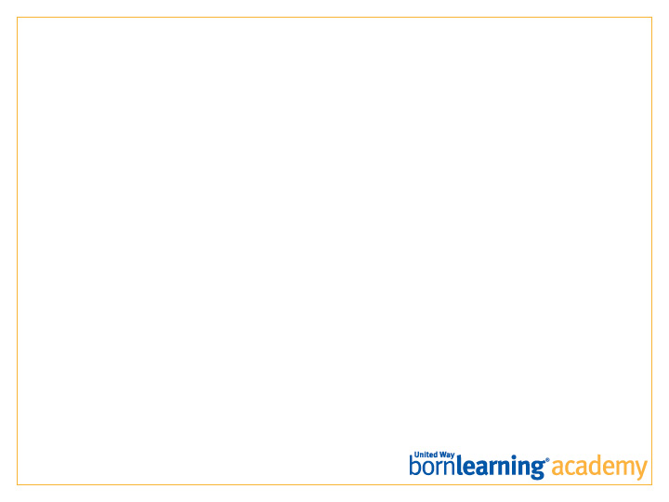
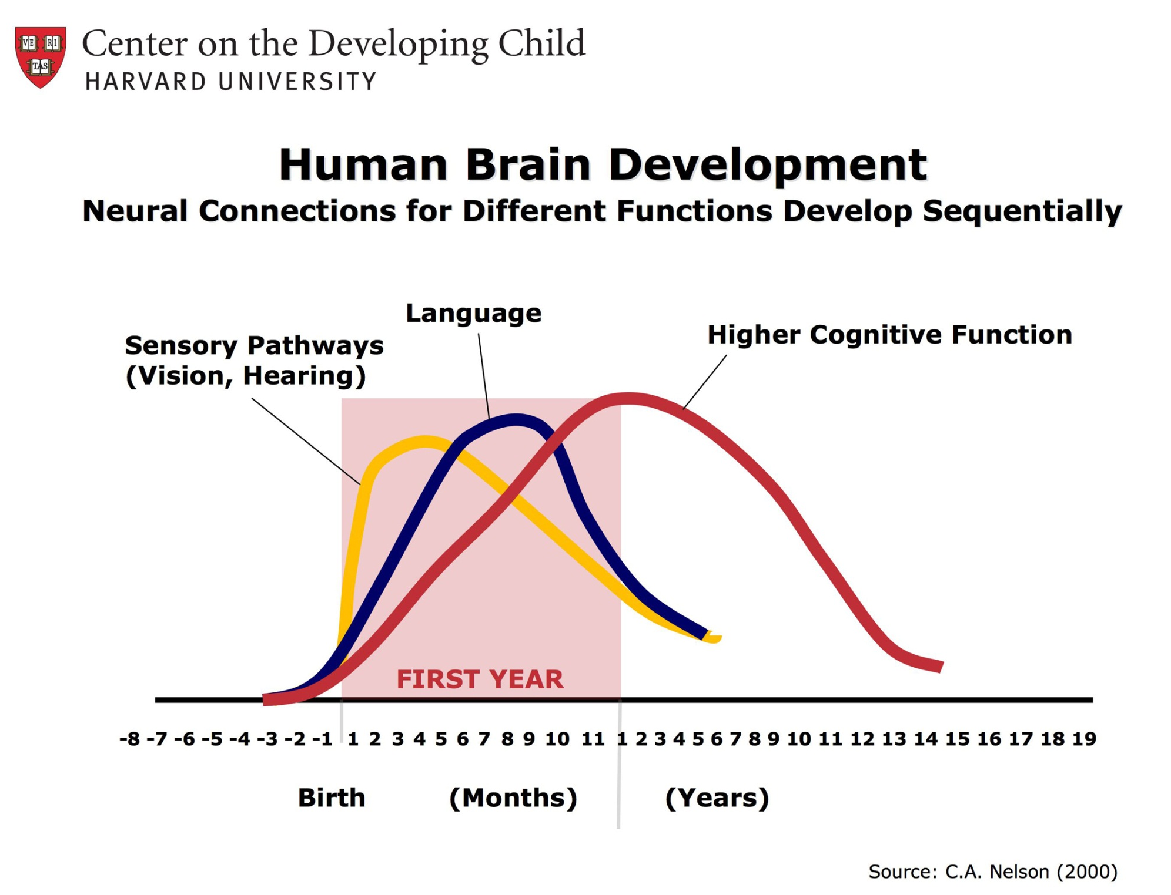
Notes:
Genes determine WHEN this blooming of neural connections (wiring) takes place
Explain
Genes also determine WHEN this blooming of neural connections (wiring) take places and in what order.
For example, sensory circuits such as those needed for seeing and hearing are the first to develop (bloom),
followed by the circuits need for early language skills such as talking.
Circuits needed for higher cognitive functions such as thinking, judgment and decision-making begin developing (bloom) later and take much longer to be wired.
Segue…
Okay. So the brain goes through a process of creating lots and lots of neural connections.
Now, let’s look at how everyday experiences turn these many connections into something called neural networks.
Depending upon your audience, you may want to explain this graph in more detail. The primary point is that different parts of the brain develop at different times. Because circuits needed for seeing, hearing and talking develop early, it is very important that children have lots of sensory (hands-on) experiences and that families spend time talking with their children starting at birth.
Graphic courtesy of Center on the Developing Child at Harvard University. Originally published in Nelson, C.A. (1999) Change and continuity in neurobehavioral development: lessons from the study of neurobiology and neural plasticity. Infant Behavior and Development, Volume 22(4) 415-429. Cited in InBrief: The Science of Early Childhood Development, presentation summary from the National Symposium on Early Childhood Science and Policy, Cambridge, MA, June 2008.

Slide 13
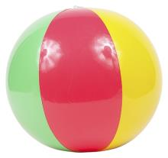
DIFFERENT NEURONS RESPOND TO
DIFFERENT INFORMATION
b
l
a
“Ball”
Notes:
Explain
One of the things we know about neurons is that neurons in different “rooms” of the brain respond to (are activated by) different types of information (sensory data).
For example, information about what you see (visual information received through the eyes) is sent to the back of your brain to the “seeing room” of the brain where different neurons will respond to different types of visual information such as color and the shape of objects.
So, when you look at this ball, different groups of “seeing” neurons respond to the different colors and the lines that make up the shape of the ball.
Use a beach ball as a training prop to catch participants’ attention. Bounce in your hand, and/or throw to a participant.
Likewise, when you hear the word “ball”, the individual sounds that make up the word “ball” (b-a-l) are sent to the “hearing” room where different groups of “hearing” neurons will respond to these three individual sounds.

Slide 14
NEURONS THAT FIRE TOGETHER ARE
WIRED INTO NEURAL NETWORKS
Ball
b
l
a
“Ball”
Notes:
Explain
When neurons “fire together,” meaning when a set of neurons respond (or are activated) at the same time, the connections between these neurons become wired together forming a specific circuit that is referred to as a neural network.
A neural network is a lot like Sprint’s “circle of friends” – a group of neurons that communicate with (call) each other.
Because these different sets of neurons “fired together” (responded at the same time) when this brain saw this ball, they become wired together, forming a neural network that will be activated every time the brain sees this ball.
The gray dashed line represents the neural network.
The same thing happens with the neurons in the “hearing” room. Because these neurons “fired together” when this brain heard the word “ball,” they became wired together, forming a neural network that will be activated every time this brain hears the word “ball.”
At first, these neural networks will be weak. But the more these neural networks are used (e.g., hear the word “ball”, see a ball), the stronger the connections in the network become (Sprenger, 1999).
This is one of the reasons why children want to do things over and over (e.g., read a favorite book or sing a favorite song). This desire for repetition is driven by the brain’s need to strengthen neural networks.
Eventually, this brain will connect these two networks, forming a larger network that the brain labels “ball.”

Slide 15

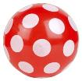


EXPERIENCES EXPAND AND REFINE
NEURAL NETWORKS
Hard
Soft
Smooth
Ball
b
l
a
Bounce
Throw
Notes:
Explain
As this brain has more and more experiences with balls, it will continue to create and add new neural networks that expand and refine this person’s understanding of the concept of ball.
In reality, this is a very simple example of a very complex process that occurs each child time your child sees, hears, touches something and that information is processed by his/her brain.
These neural networks influence everything from your ability to recognize a letter of the alphabet to your ability to speak a word to your ability to control an emotion such as anger.

Slide 16
WIRING THE BRAIN
Brain makes connections between neurons.
Experiences strengthen connections, creating neural networks.
Unused connections are pruned making the brain more efficient.
Notes:
Summarize
So basically, brain development is a process that involves the “wiring” up of connections between neurons.
Initially, the brain “blooms” lots and lots of connections between neurons.
Experiences determine which of these connections are strengthened and become wired together as neural networks. The more your child’s brain uses a specific neural network, the stronger the connections in that network become (Sprenger, 1999). (Neurons that “fire together” are wired together)
Other connections that are not used are pruned away to make the brain more efficient. (“Use it or lose it” principle)
Sprenger, M. (1999). Learning & memory: The brain in action. Alexandria, VA: ASCD.

Slide 17

Notes:
Explain
Earlier, I explained that the brain goes through a period where it “blooms” lots and lots of connections between neurons.
So, imagine that now you have this garden (brain) that has too many flowers (neural networks) – the garden is too crowded.
A good gardener knows that pruning back some of the flowers will lead to a better, healthier garden.

Slide 18
THE BRAIN “PRUNES” UNUSED
NEURAL CONNECTIONS
“Use it or lose it”
Notes:
Explain
The same things happens in the brain.
During this blooming of connections which takes place during the first 3-5 years, the brain ends up with more connections (synapses) than it needs.
So, like a gardener, the brain “prunes” (weeds out) unnecessary connections – connections that haven’t been used – and keeps the connections that have a purpose. This pruning gives the most used connections more room to grow and expands and increases efficiency of the remaining connections.
Consider using pruning shears as a prop that will catch participants’ attention and give them a visual to remember this concept (pruning).
The pruning of unnecessary connections is sometimes referred to as the “use it or lose it” principle. The brain keeps the connections it uses and loses the connections it doesn’t need.
So, although genes initiate a “blooming” of neural connections, it is the experiences a child has that determines which connections are kept and strengthened and which neural connections are eliminated.
If you included the marshmallow activity on slide 11, complete the activity here. Ask participants to remove some of the toothpicks connecting the marshmallows. This represents the “pruning” that takes place.
Segue…
How infants learn language is a good example of both the “use it or lose it” principle and of how experiences shape the developing brain.

Slide 19
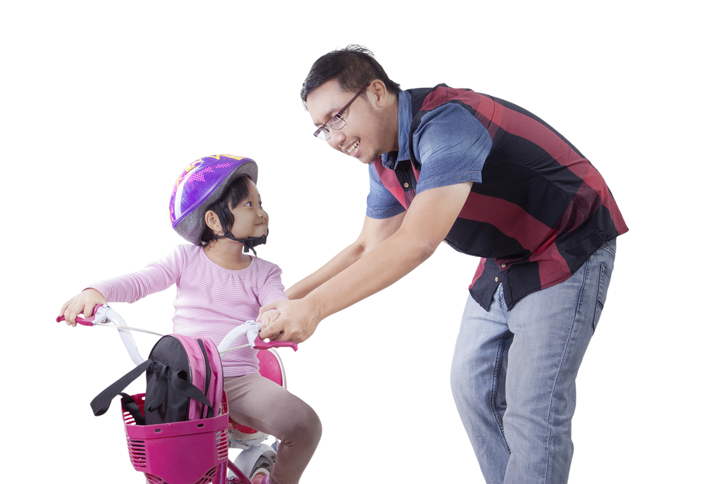



YOU HAVE A NEURAL NETWORK FOR EVERYTHING YOU KNOW, DO AND FEEL

Slide 20

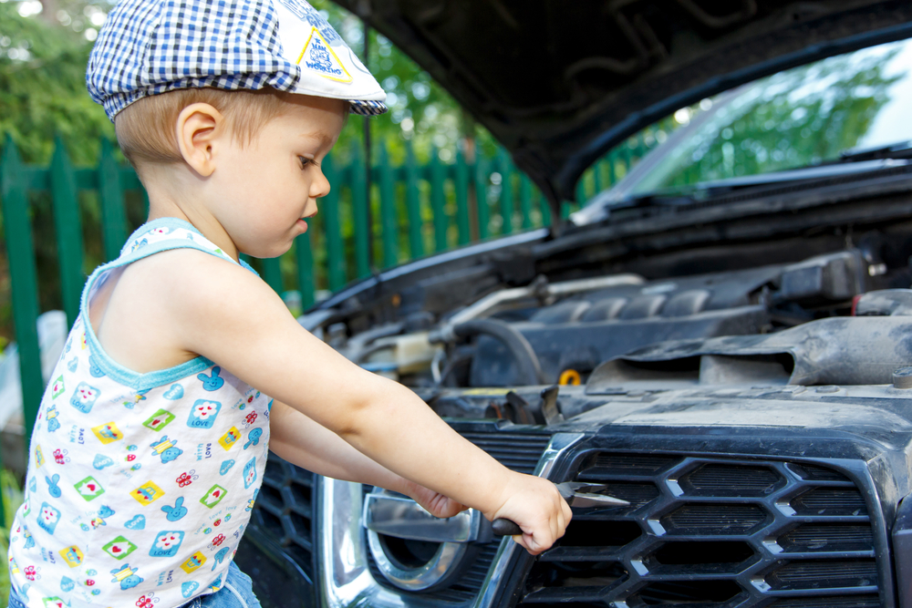
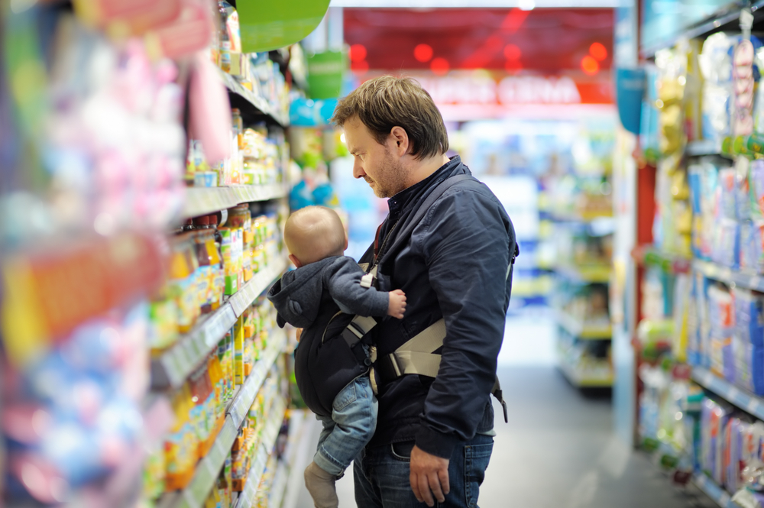
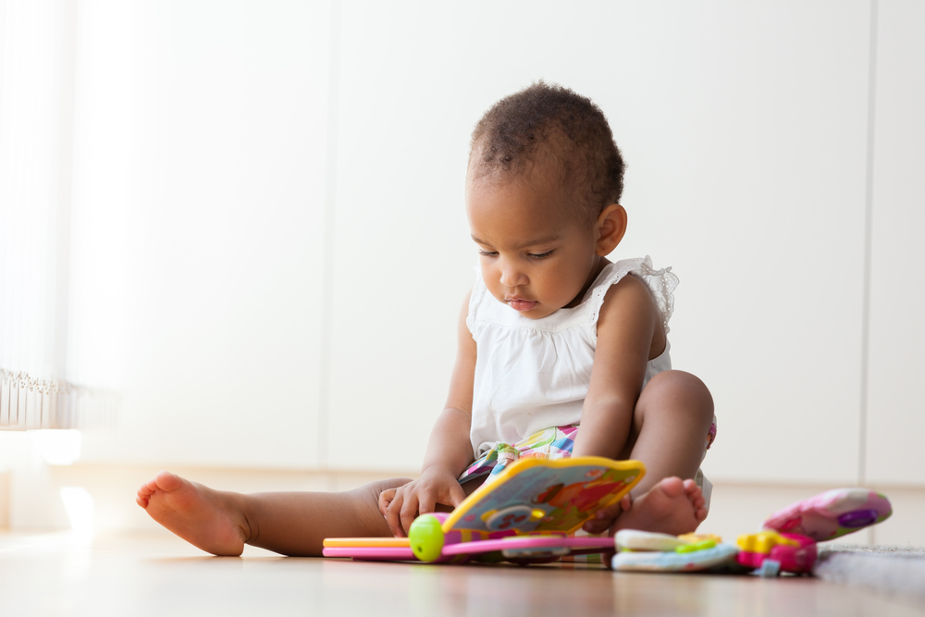
EVERYDAY EXPERIENCES BUILD
NEURAL NETWORKS
Notes:
Explain
As a parent or grandparent or foster parent, you will determine the kinds of everyday experiences and interactions that will build the neural networks that will become the foundation for everything that your child will know, do and feel.
This is why early experiences during your child’s first five years are so important.
Early experiences literally shape the brain, building the foundation upon which everything your child ever learns will be based.
The experiences and interactions your child has with people and objects in his/her environment will determine which connections are used and which are not and therefore, which connections will be kept and which will be pruned.
So, although genes are responsible for creating the brain’s structures and for producing lots of neural connections, it is the child’s specific experiences and interactions that will fine-tune these connections and shape the way the brain develops. It is your child’s experiences that determines which of those neural connections are strengthened and formed into the neural networks that we talked about earlier.
Now here is the good news. You don’t have to run out and buy specific toys or do specific things to “make your child smarter.”
Many of the things you already do everyday contribute to your child’s brain development.
Scientists have found that normal everyday experiences and loving, responsive adult/child interactions seem to provide the exact kinds of experiences a child’s developing brain needs.
When you provide your child with age-appropriate materials to play with and when you spend time with your child – playing, reading, singing – your child gets the kinds of experiences needed to develop his/her brain and prepare him/her to succeed in school.
However…these are the very things that get lost in the shuffle in today’s busy families.

Slide 21
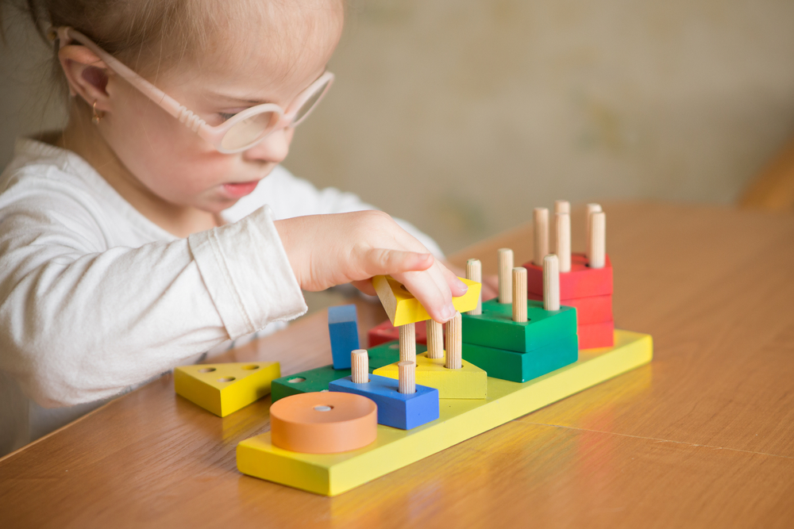
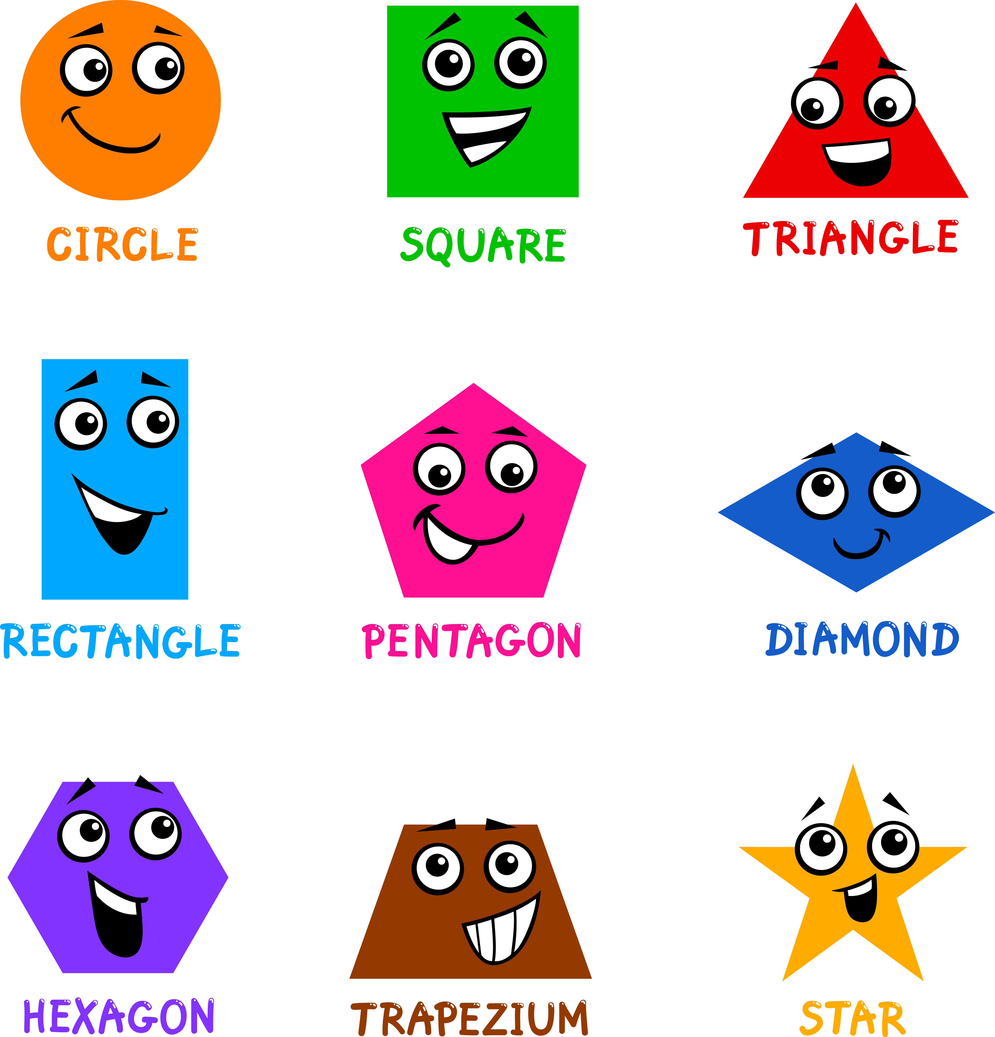
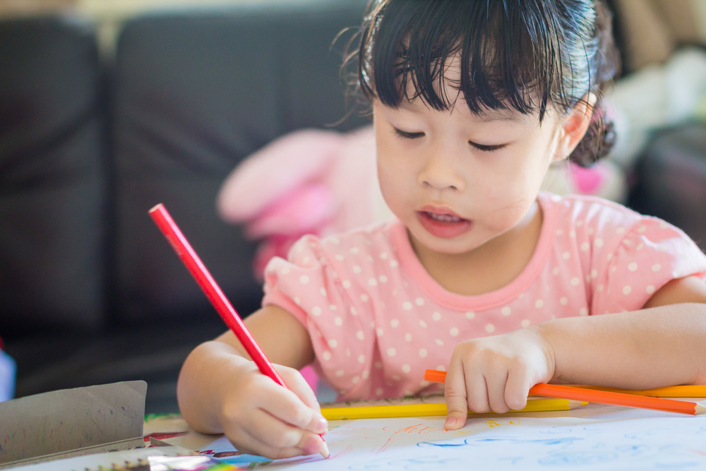
THE MORE WAYS SOMETHING IS
EXPERIENCED, THE BETTER
Notes:
Explain
When it comes to learning, having lots of neural networks involving multiple rooms in the brain is best.
This means that the more different ways children learn about and experience things and the more senses that are involved, the better.
Let’s take the example of learning about shapes.
When a child has opportunities to play with blocks of different shapes, read books about shapes, create art using different shapes, play with shape toys and puzzles, and to talk about shapes, the brain makes multiple connections between neurons in different rooms of the brain. This makes it easier for the brain to access information about shapes when needed.
So, as a parent, you don’t need to use a worksheet or flash cards to teach your child about shapes. You can take advantage of everyday experiences to talk about and help children learn about shapes – such as talking about how plates are circles, cereal boxes are rectangles, etc.

Slide 22
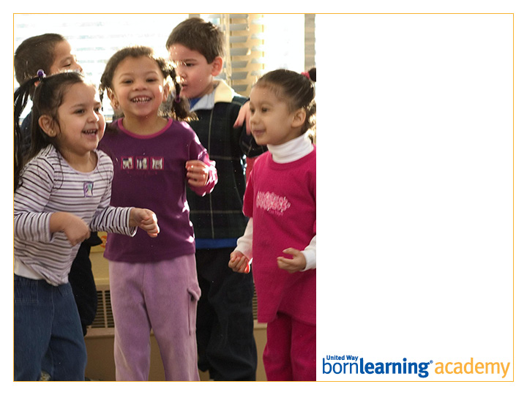
Post-Test

Slide 23
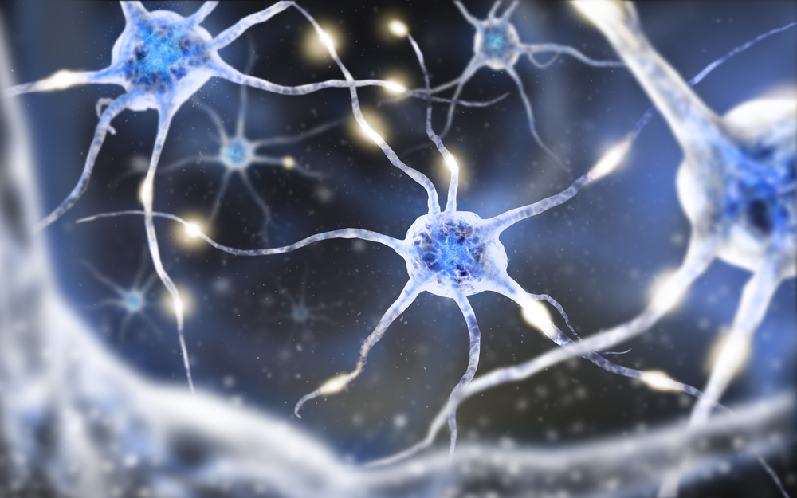
HOMEWORK
Play with your child or try one of the following activities to build your child’s brain.

Slide 24
ACTIVITIES
Float or sink?
Homemade shape puzzles
Shape hunt and sort
Retelling stories

Slide 25

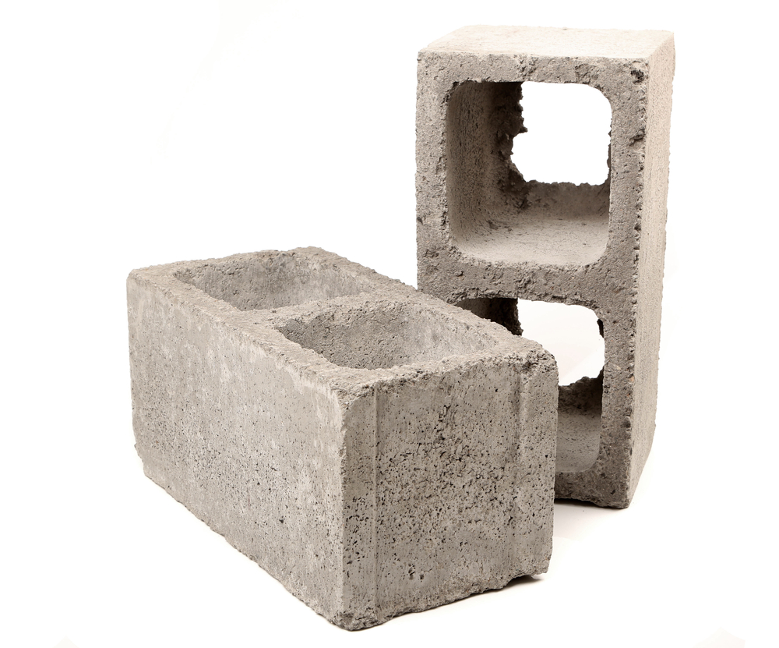


FLOAT OR SINK?

Slide 26
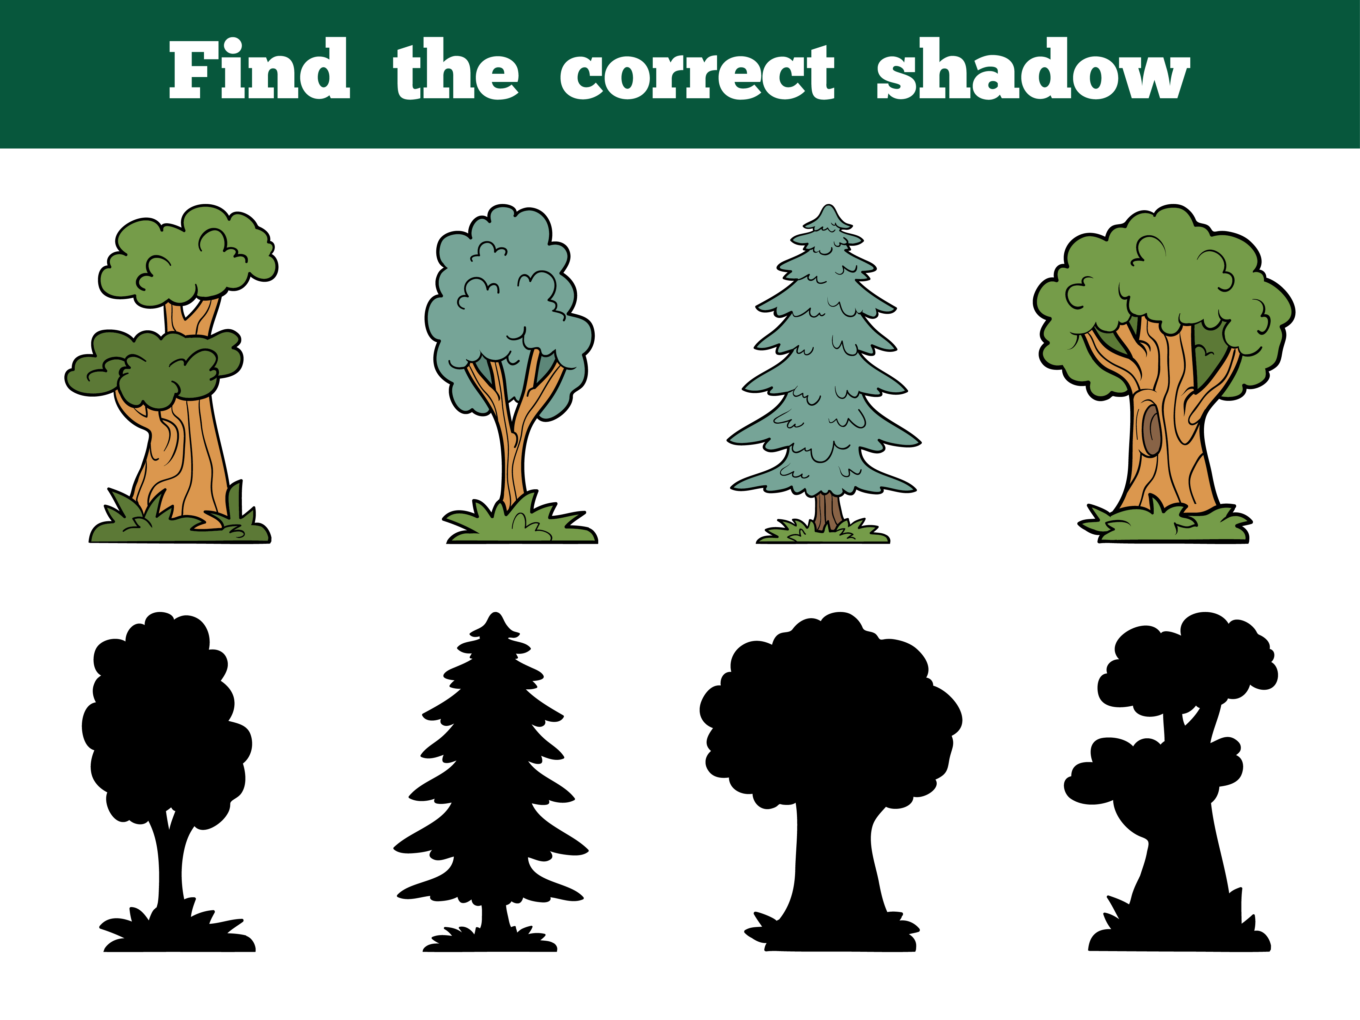
HOMEMADE SHAPE PUZZLES

Slide 27
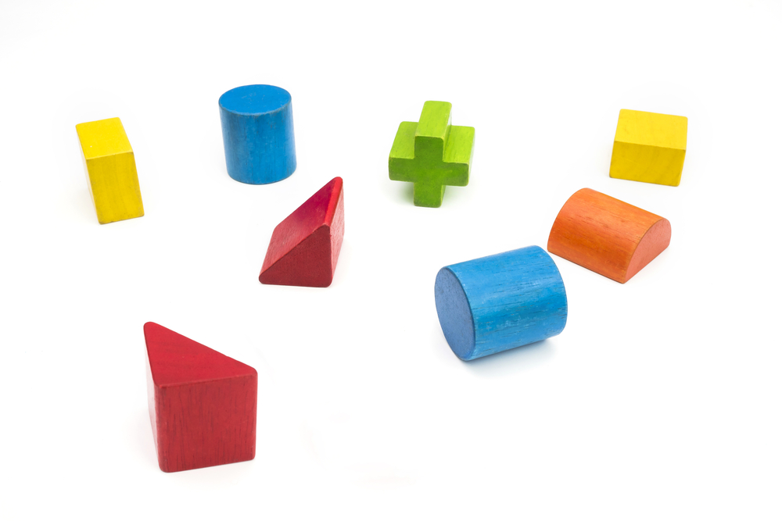
SHAPE HUNT AND SORT

Slide 28

RETELLING A STORY

Slide 29


Slide 30
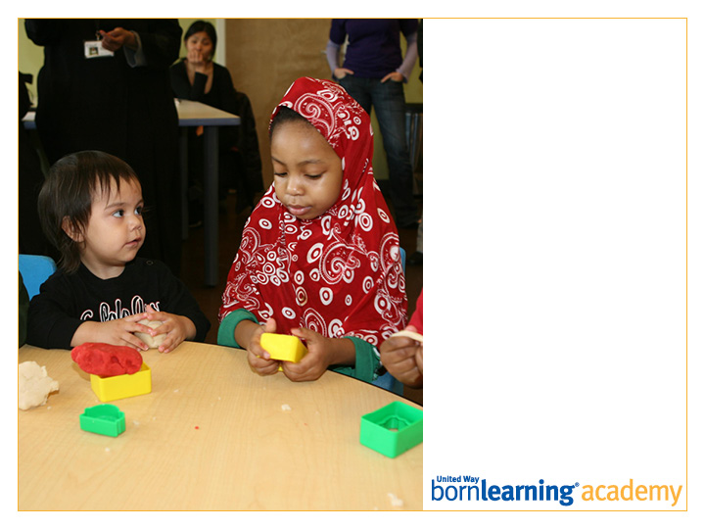
Thank you!
Workshop 6:
DATE AND TIME

Slide 31
SECTION HEADLINE
Deck style

Slide 32
SECTION HEADLINE
Deck style

Slide 33
SECTION HEADLINE
Deck style

Slide 34
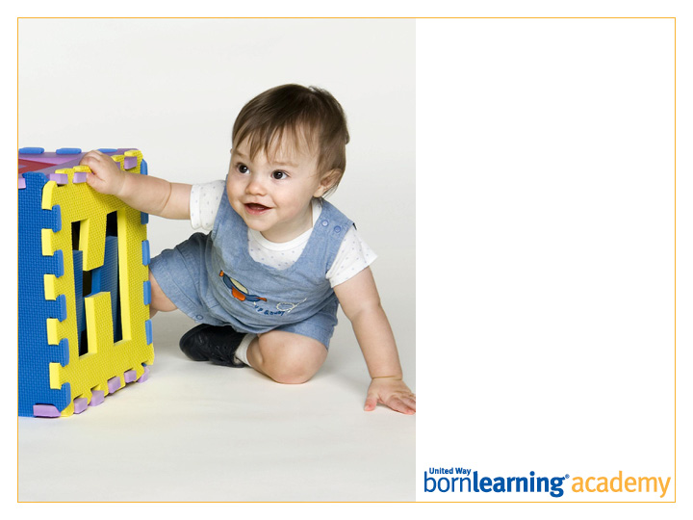
SECTION HEADLINE
Deck style

Slide 35
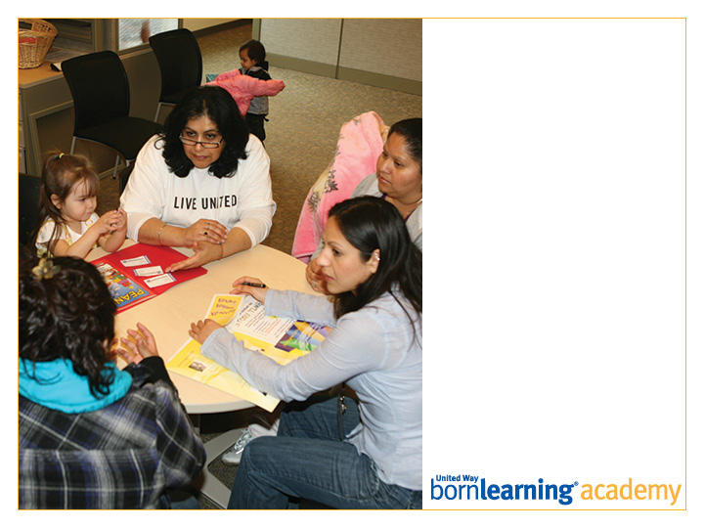
SECTION HEADLINE
Deck style

Slide 36
SLIDE TITLE GOES HERE
Bullet copy style
Bullet copy style
Bullet copy style
Bullet copy style

Slide 37
Open Copy/Layout Slide

