Slide 1

United Way
Born Learning Academy
Session 4

Slide 2
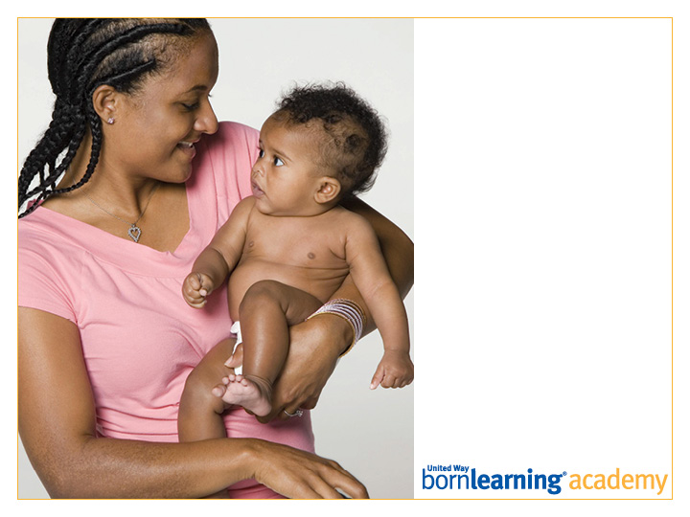
Pre-Test

Slide 3
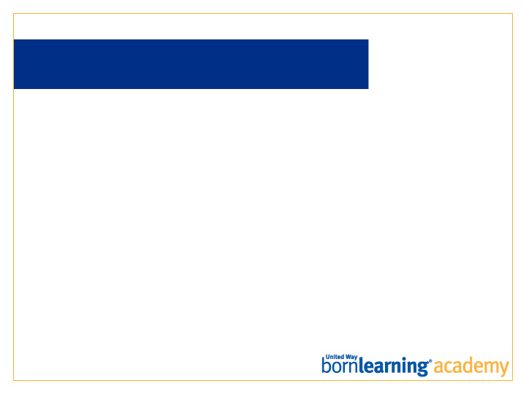
AT THE END OF THIS SESSION, PARTICIPANTS WILL BE ABLE TO:
Provide one explanation of how nutrition and health are tied to learning.
Prepare a healthy snack with children while promoting early learning.

Slide 4
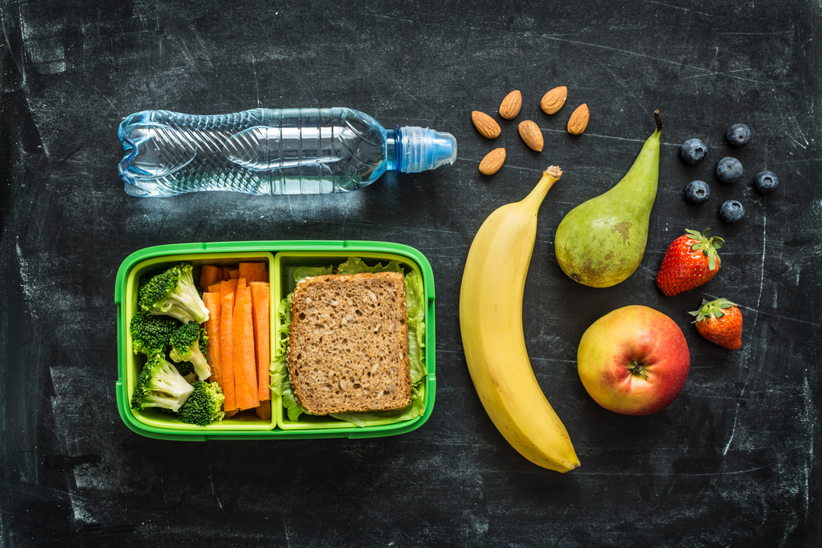
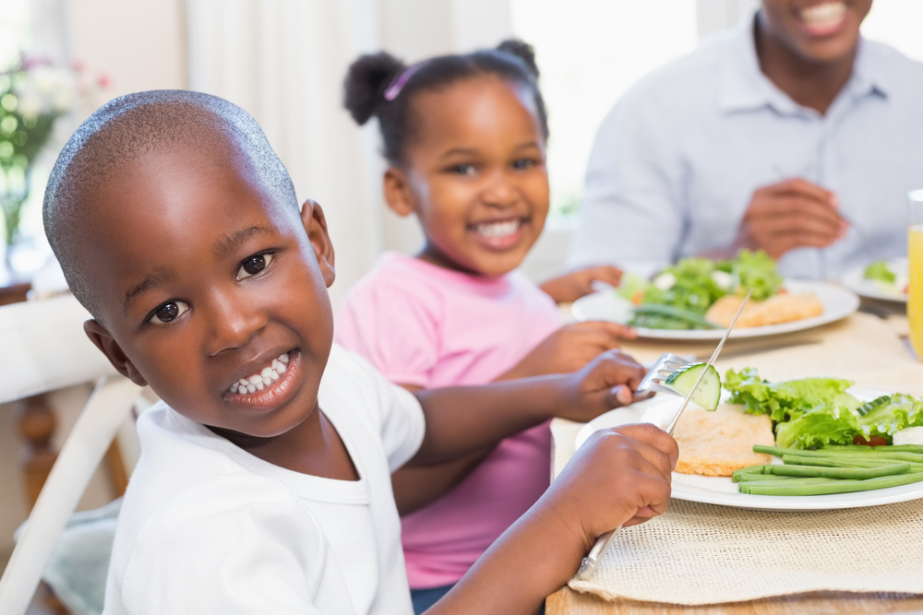
NUTRION AND HEALTH
The health and well-being of our children depends on
their environment and the adults around them.

Slide 5
NUTRITION AND HEALTH
As parents, it is important for us to:
Participate in child wellness checks.
Have guidelines for children, including food choices and sleeping patterns.
Encourage children to make healthy food choices by talking to them about “bad for you” food and “good for you” food.
Take care of ourselves by modeling good nutrition, sleeping, and healthcare choices.

Slide 6
NUTRITION AND HEALTH
All of these factors affect how a child learns.
If a child is sick, tired or hungry, it is hard for that child to learn.
What can you do to prevent your children from getting sick?

Slide 7


Slide 8
PREVENTING SICKNESS
Talk with your doctor if you have any questions.
Dress children appropriately for the weather (to prevent frostbite and sunburn and allow them to be comfortable playing outside).
Provide opportunities for children to get plenty of exercise.
Teach proper hand washing. Wash hands before and after eating, after using the bathroom and when returning home from school.

Slide 9

WHEN THEY DO GET SICK…
Keep child home from school/day care.
Encourage lots of sleep and rest.
Make sure child drinks lots of fluids.

Slide 10
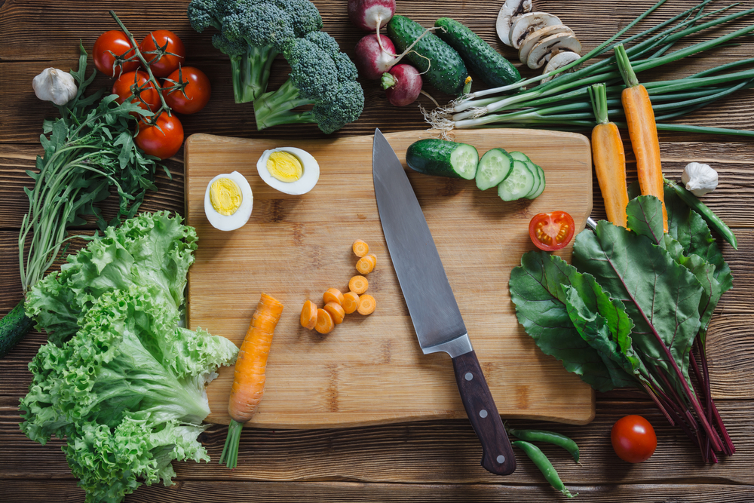
YOUR CHILD’S NUTRITION
All children have different eating habits.
Discuss good food options using language children understand (“junk food” vs. “grow food”).
Only allow junk food in moderation. Nutritious foods provide fuel for the body and brain.
Involving children in food preparation may increase their interest in eating foods.

Slide 11
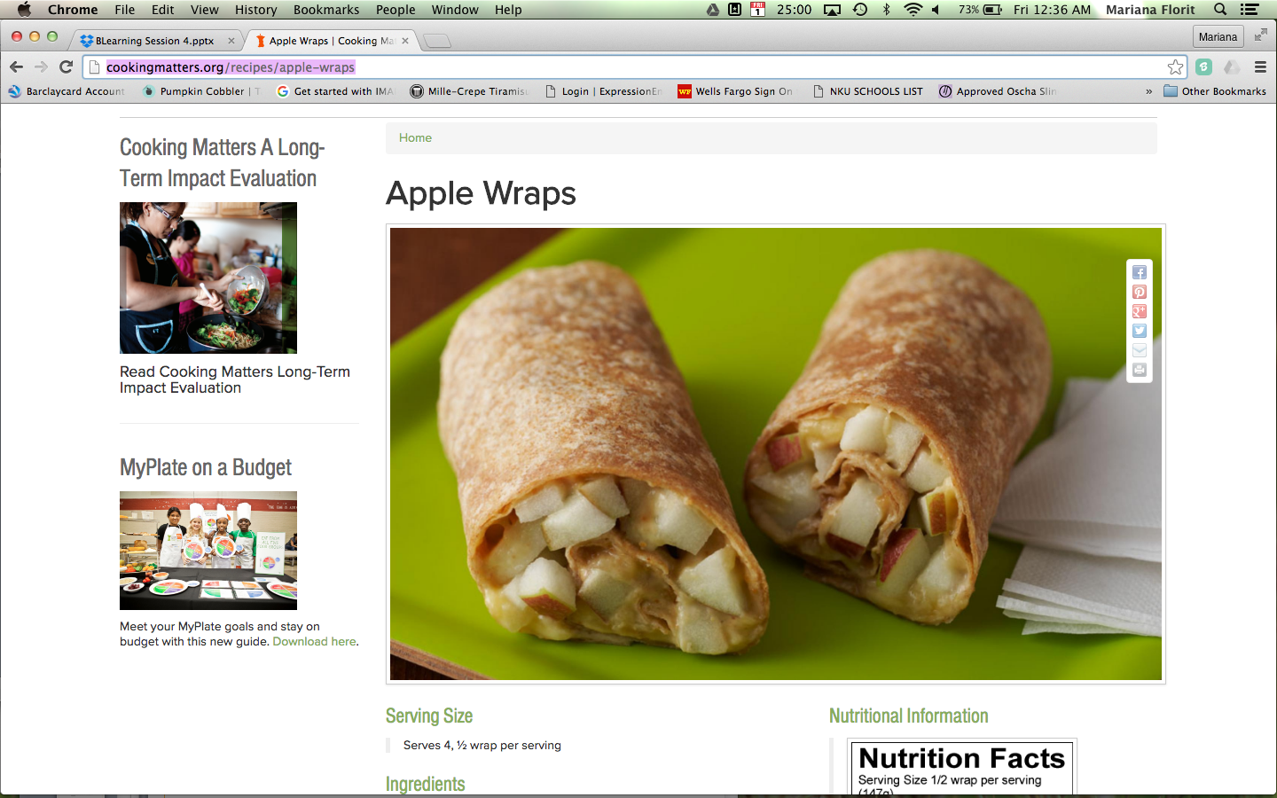
NUTRITION MADE SIMPLE
http://cookingmatters.org/recipes/apple-wraps
Ingredients
1 large apple
2 medium, ripe bananas
2 tablespoons peanut butter
2 (8-inch) whole wheat tortillas

Slide 12

SLEEP
Sleeping the necessary hours helps children stay mentally and physically healthy. Sleep is also important for memory, learning and concentration.
Toddlers: 12-14 hours of sleep (within 24 hour period). Around 18 months, nap times will decrease to once a day, lasting about one to three hours.
Preschoolers: 11-13 hours each night.
5 – 12 Year Olds: 10-11 hours each night.

Slide 13


Slide 14
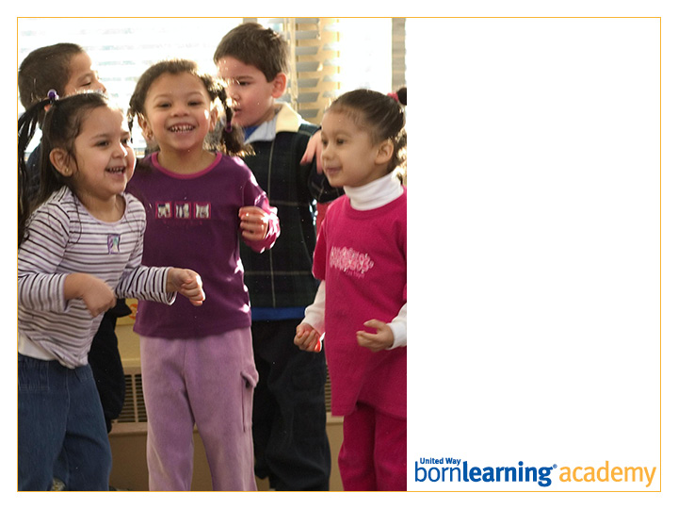
Post-Test

Slide 15
HOMEWORK
Prepare a healthy snack with your child. Get creative!

Slide 16
ACTIVITY: SNACKS
A Healthy Snack: Grinch Kabobs
A Healthy Plate and Manners
Glow Germ

Slide 17
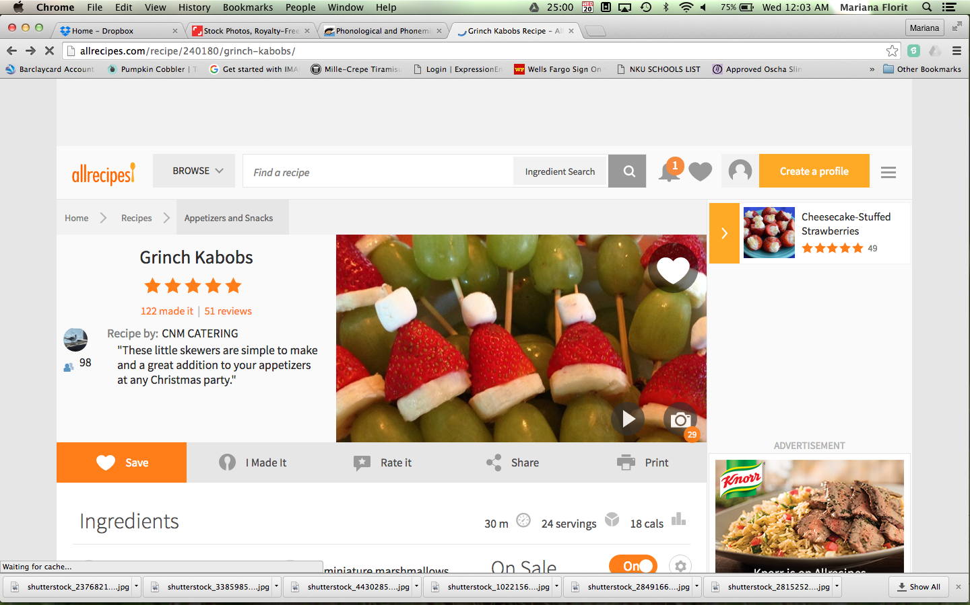
ACTIVITY: HEALTHY SNACK
Grinch Kabobs: http://allrecipes.com/recipe/240180/grinch-kabobs/

Slide 18
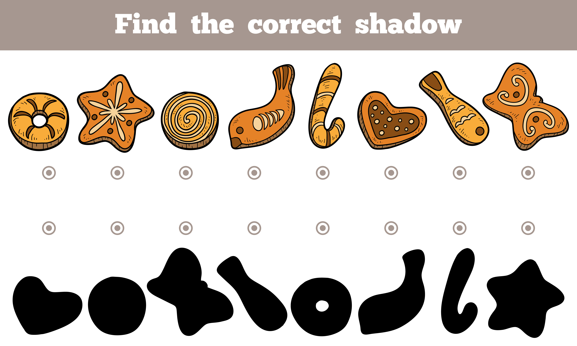
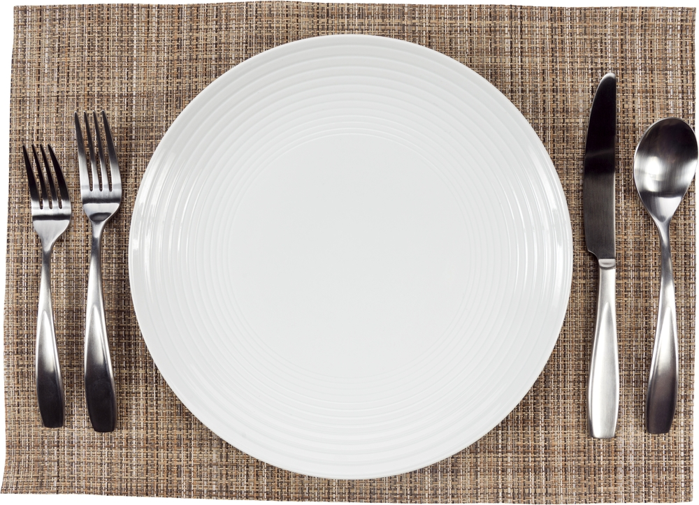
ACTIVITY: A HEALTHY PLATE
AND MANNERS
Teach children table manners while they make food choices.
Place different food (printed pictures of food) on plates with glue to make a healthy plate.
Notes:
Print and cut out pictures of foods, and have kids glue them onto paper plates.

Slide 19
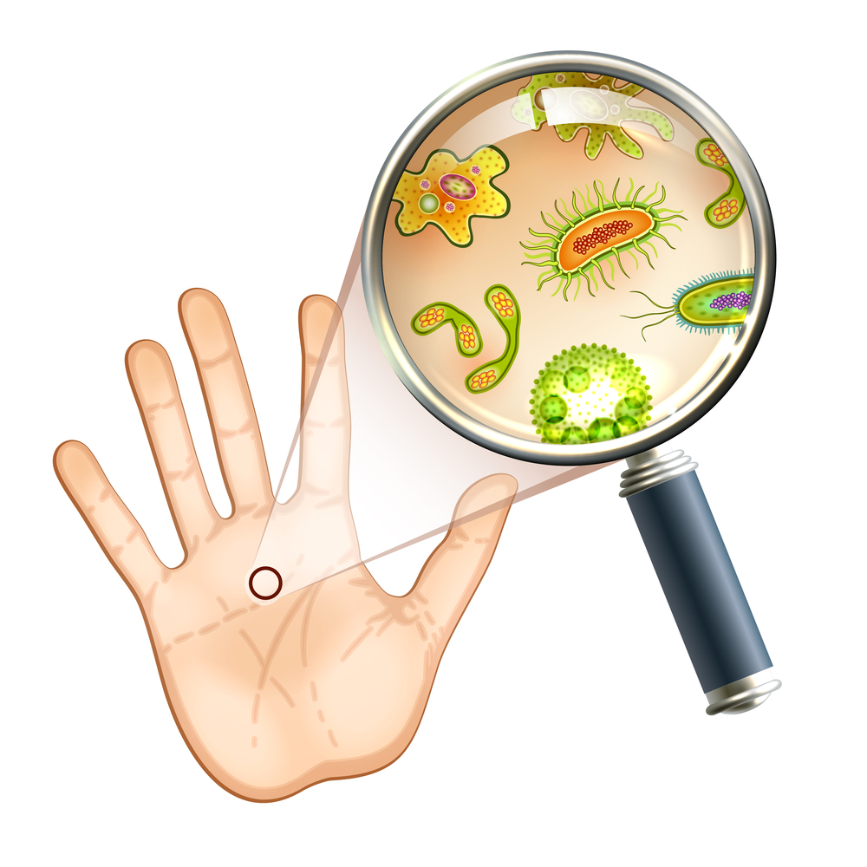
ACTIVITY: GLOW GERM
Help your child understand why hand washing is important.
Look at the germs on your hands under a black light. Wash your hands, then look at them again under the black light.

Slide 20
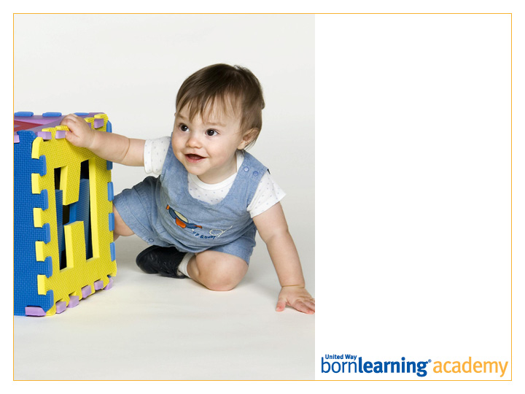
Thank you!
Workshop 5:
DATE AND TIME

Slide 21
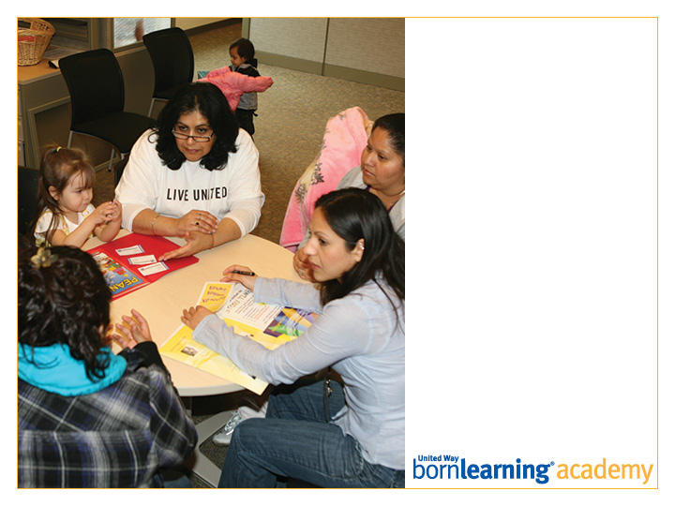
SECTION HEADLINE
Deck style

Slide 22
SLIDE TITLE GOES HERE
Bullet copy style
Bullet copy style
Bullet copy style
Bullet copy style

Slide 23

Open Copy/Layout Slide

