Slide 1
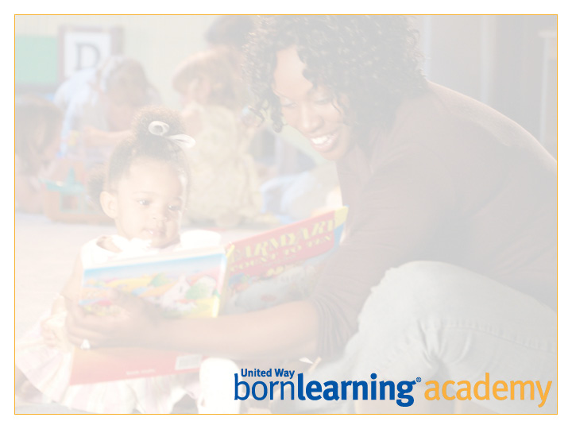
United Way
Born Learning Academy
Session 3

Slide 2
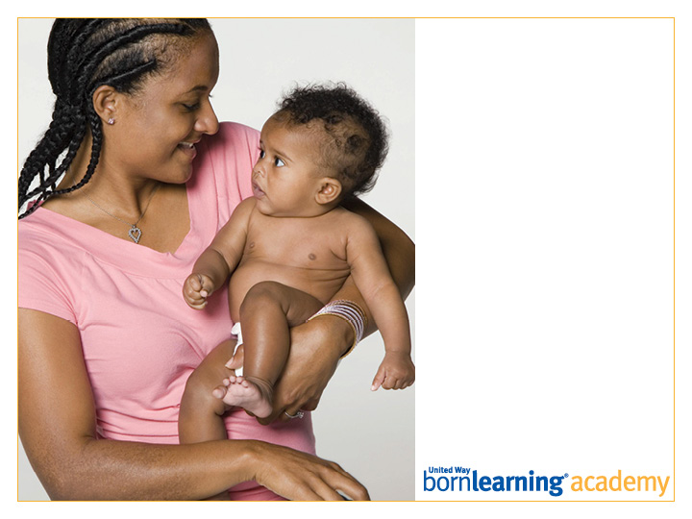
Pre-Test

Slide 3
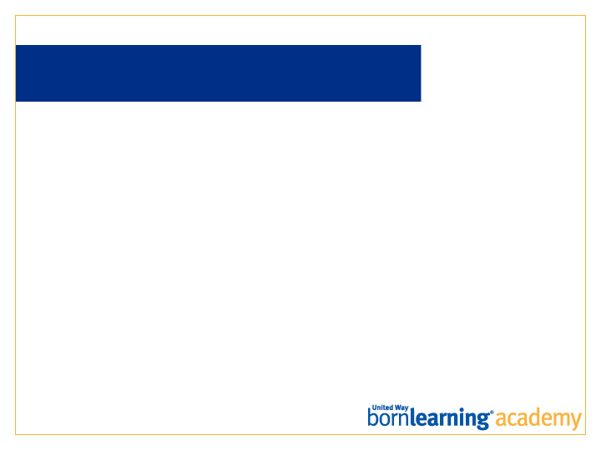
AT THE END OF THIS SESSION, PARTICIPANTS WILL BE ABLE TO:
Describe how play encourages literacy.
Ask questions to children during shared reading experiences.

Slide 4
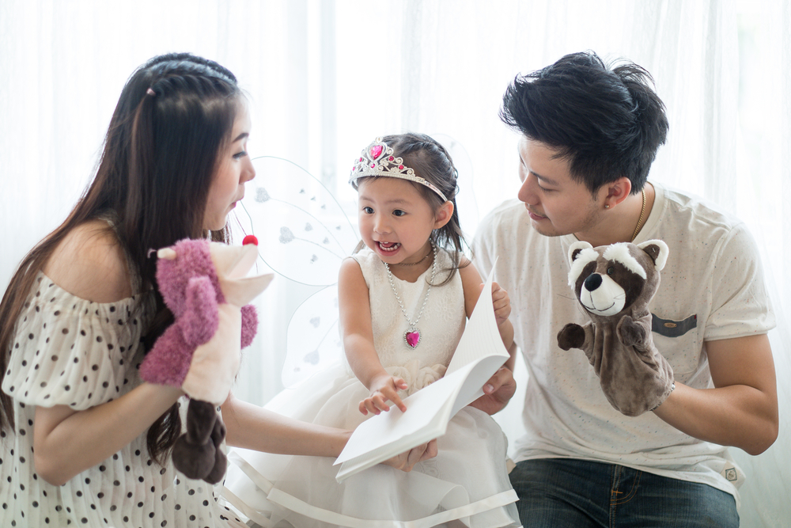
LANGUAGE IS LEARNED THROUGH RELATIONSHIPS
Language is acquired in the first years of life as we engage in imitation, turn-taking, verbal and non-verbal communication.
Notes:
The learning of language requires a sender and receiver who are motivated and tuned in to each other. Language cannot be learned in isolation or through rote practice. Research has shown that there are significant and meaningful differences in how young children acquire language based on the responsiveness of their caregiver.

Slide 5

RESEARCH FINDINGS
Children who are read to have a large vocabulary and better language skills when they start school.
By age 3, children have already developed many literacy skills and attitudes.
Notes:
There are windows of opportunity for acquiring skills.

Slide 6
WHY BOOKS WITH YOUNG CHILDREN?
Introduces the left-to-right reading process.
Exposes the child to an exciting, new world through stories and informational titles.
Allows the child to hear the patterns of his/her language.
Connects a child with an adult.
Adults and children exhibit certain positive social-emotional skills when sharing books together.

Slide 7

REMINDERS
It is important to understand your child’s feelings. Children need to be able to play with words and language.
Remember to find topics they like or things they can relate to from their own experiences.
Just think of all the places they will go!
Notes:
Go to next slide for examples.

Slide 8
SHARED READING: WHAT IS IT?
Shared reading allows adults and children to read together and interact with the book together.
Repetition of the same book helps children with recognition.
Children learn something different each time the book is read.
Adults model strategies used to read.

Slide 9
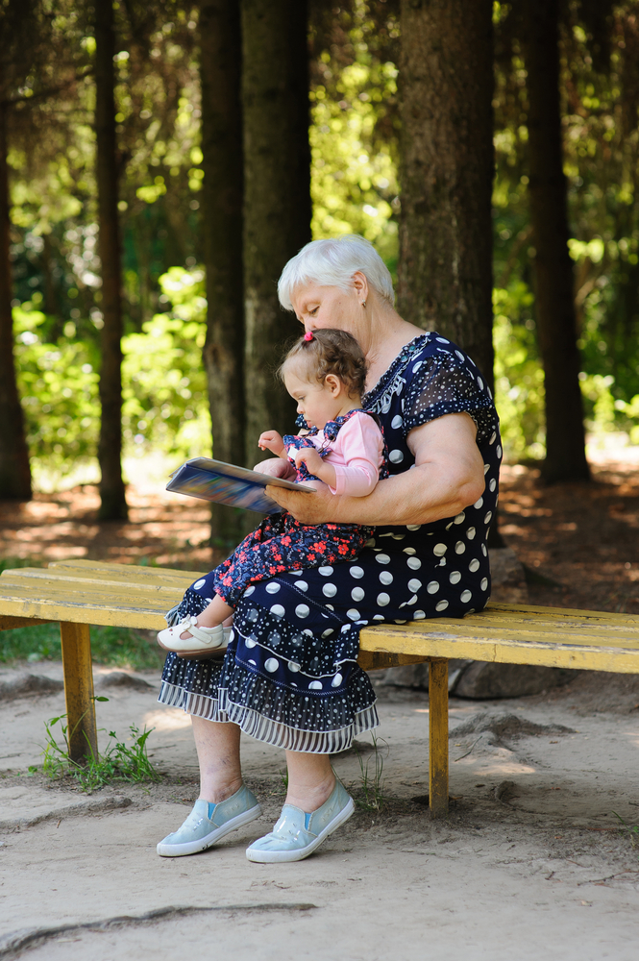
SHARED READING: WHAT ADULTS DO
Hold the book so children can see the words and pictures and read along with you.
Point to the words as you read.
Pause and let children finish the repeated phrases.
Ask questions about the pictures on the page.
Make connections to real life and everyday life or events you did with your child.

Slide 10
SHARED READING:
MAKE READING FUN!
No matter when children learn to read, if they do not enjoy it, they will not read.
Find topics children are interested in.
Make book connections to everyday life as often as possible.
Read throughout the day (signs, packages, menus).

Slide 11
SHARED READING:
CONNECT WITH FUN AND GAMES
Singing and playing with children allows them to be actively involved.
Children can do movements connecting words to actions.
Using songs and games makes learning fun and allows children to be successful.
A familiar song allows children to repeat and play with words.
Familiar songs can be connected to books.

Slide 12

WHY MUSIC WITH YOUNG CHILDREN?
Powers the brain: connects neural pathways.
Influences: stimulates creativity.
Connects: brings diverse groups together.
Transports: in time and emotion.
Comforts: security and memories.
Did someone sing songs to you as a child?

Slide 13
SINGING SONGS
Twinkle, twinkle little star,
How I wonder what you are.
Up above the world so high,
Like a diamond in the sky.
Twinkle, twinkle little star,
How I wonder what you are.
Notes:
[Presenter: This is an optional activity. Include or exclude it depending on your audience and the time available. If you use this slide, have a recording of “Twinkle, Twinkle Little Star” ready to play.
First read “Twinkle, Twinkle Little Star.” Then play a recording of someone singing it. Point out how singing slows down language. This helps children hear the sounds that make up words.]

Slide 14
CLAPPING AND STOMPING TO
MAKE THE BEATS
Steg-o-saur-us,
Steg-o-saur-us,
In a swamp,
In a swamp.
Spikes upon his tail,
Sharper than a nail,
Stomp, stomp, stomp!
Stomp, stomp, stomp!
(tune: Are you sleeping?)

Slide 15
WHY FINGER PLAYS
WITH YOUNG CHILDREN?
Promotes love of rhythm and movement.
Helps children to develop creativity.
Encourages greater self-esteem.
Promotes and encourages verbal and motor skills.
Helps a child observe and follow along/focus.
Practice finger play examples.

Slide 16
PRINT AWARENESS
I SEE WORDS
Notes:
PRINT AWARENESS - Print awareness is noticing print everywhere, knowing how to handle a book and knowing how to follow the words on a page.
This includes learning that writing in English follows basic rules such as flowing from top to bottom, flowing from left to right, and that the print on the page is what is being read by someone who knows how to read. This may be a bit different for some languages.
Why is this important? As we share books the child learns how books work. Children must become aware of words before they can read them. When children feel comfortable with books, they can concentrate on reading.
Noticing print everywhere
Knowing how to handle a book
Knowing how we follow the words on a page
Point to signs around you and say the words ex. Name the Cheerios box (0-1)
Let your child turn the pages (0-1)
Read books with your baby and let them handle books (0-1)
Recognize signs; talk about print in your house, neighborhood, etc. (2-3)
Occasionally follow the words on the page with your finger (2-3) DEMO
Make a game of putting the book right side up; backwards, etc. (2-3)
Give your child access to paper and writing tools (4-5)
Choose a workshop book and demonstrate following words on a page and the game of holding the book correctly

Slide 17

WHAT CAN YOU DO?
Point to words and signs around you and say the words. (STOP or EXIT)
Read books with your children, and let them handle the books and turn the pages.
Occasionally follow the words on the page with your hand (sweeping action).
Make a game of putting a book right side up; backwards, etc.
Give children access to paper and writing tools.

Slide 18

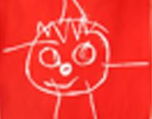
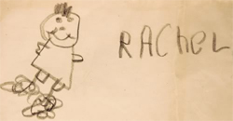
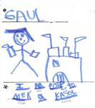
WRITING
Making Marks
Drawing & Writing
Name Writing
Word Writing
Notes:
[Presenter: Ask participants how it would feel to write their name or draw with their non-dominant hand. Or, alternatively, have them actually try this and ask how it felt. Point out that children need time and practice to develop the physical ability to write.]
Points to make
As children scribble and draw, they practice eye-hand coordination and exercise the muscles in their fingers and hands. This helps develop the fine motor control they need to write letters and words.
Encourage your children to “sign” their name on their drawings. Even if this begins as a scribble, children learn that they can write something that represents their name. Later your child will write the initials of his or her first and last name and then the complete name.
Ask your child to label parts of his or her drawings. This also helps your child understand that letters and words stand for things.

Slide 19

VOCABULARY
I KNOW WORDS
Notes:
VOCABULARY is knowing the names of things
Most children enter school knowing between 3,000-5,000 words.
Use many words and a variety of words
The best way to help children learn new words is to talk and read with them
Pause in your reading to explain unfamiliar words
Label more than just things, label feelings, yours and your child’s.
Use your own language
Books often include words not used in daily conversation.
Why is it important for children to hear a wide range of vocabulary and to expose them to many words?
Children need to know the meaning of words to understand what they are reading.
When you think about it, you know if you are reading a word correctly if you have heard it before. You are sounding it out. The more words children hear, the more ready they will be to make connections when they read.
Give them words – lots of words to describe their world, their feelings and their questions! Vocabulary begins to develop at birth and continues to grow throughout the child’s life. Reading or sharing books with children is one way to talk with them and it introduces them to the world. Even if they have not seen an actual cow, they can learn that there is such an animal by seeing a picture of one in a book.
If you are fluent in a language other than English, research shows that it is best for you to speak to your child in the language you know best. This allows your child to hear language spoken fluently, and allows you to explain many things to your child that you might not be able to do in English. The child will learn concepts and discuss thoughts and ideas that are more complete, and will be able to translate what he knows when he gets to school. Infants are born being able to understand the phonemes of all languages, but this ability is pruned if they don’t hear the language. Children can easily grow up bilingually.
Read the first page of Caps for Sale and point out words we don’t use in every day conversation: peddler, caps, ordinary, wares. Tell Tailor story

Slide 20
WHAT CAN YOU DO?
Use many words and a variety of words.
Talk and read with your child:
“Baby, baby what do you see?”
Explore the feelings/emotions in words:
“Hurt.”
Pause in your reading to explain unfamiliar words.

Slide 21

NARRATIVE SKILLS
I CAN TELL A STORY
Notes:
NARRATIVE SKILLS – The ability to describe things and events, and to tell stories.
Children start by hearing stories, but they also need to understand and tell stories and describe things. These are known as Narrative skills, and are essential for children being able to understand what they are learning to read (comprehension). Stories have a structure. Learn to predict and summarize.
This is important because begin able to talk about and explain what happens in a story helps a child understand the meaning of what he or she is reading. Good narrative skills lead to good reading comprehension.
Name things and add description (0-1)
Encourage interaction by asking a question, pausing, and then answering your own questions. Go beyond yes and no (0-1)
Read a story several times and let the child say what will happen (2-3)
Ask questions that require a response more than yes or no (2-3)
Let your child tell what is happening, 2-3 things in a row (4-5)
Ages 0-1:
Listen as child tries to talk; be patient while they shape their words*
Tell child stories or what is happening; what happened
Narrate your (their) life; tell family stories
Label things, actions, feelings, ideas; talk about them
For infants and young toddlers, encourage interaction by asking a question, pausing, and then answering your own question. Use questions that cannot be answered with yes or no. This teaches your child how conversation works, back and forth.
For babies, encourage their babbling. When they start looking away from you, they may be over-stimulated, so stop for a while. Take your cue from your baby.
Ages 2-3: (add these)
Let your child retell a story with props, dolls or puppets, felt pieces
Let your child draw and tell you what is happening in the picture
Talk with your toddler. You might say, “Put your shoes on,” or “Let’s go to the park.” Did you talk to your child? [Yes!] Did they have to say anything? [No!] The child never has to say a word.
Demonstrate having a conversation with a child

Slide 22
WHAT CAN YOU DO?
Name things and add description.
Listen as children try to talk.
Tell children stories.
Narrate your life and theirs.
Label things and talk about them.
Encourage interaction.

Slide 23
LETTER KNOWLEDGE
I KNOW LETTERS
Notes:
LETTER KNOWLEDGE - is knowing that letters are different from each other, that they have different names and make different sounds. Children need to learn that written words are made up of smaller parts.
This is important because in order to read written words, children must understand that they are made up of individual letters and each that each letter has its own name and sound
Show children how things are alike and different (0-1)
Feel and talk about shapes (0-1)
Use ABC books (2-3)
Let child see their name written (2-3)
Let child try to write letters (4-5)
Find letters in the environment (4-5)
What you can do to help your child learn about letters:
Ages 0-1:
Ages 2-3: (add)
Let child see his/her name written (This is the most important word to a child!)
Play with magnet and other toy letters (have samples on display –pick them up and show how a child can explore the shape of the letter with their hands)
Ages 4-5: (add)
Game: Letter day. Pick a letter day, for example “W.” Make waffles for breakfast, eat watermelon, and drink water. Go for a walk. Look for words that start with the “W” sound.
Show foam letters, play a game trying to find letters around us.

Slide 24
ALPHABET BOOKS, WORDS THAT
START WITH THE LETTER…
The Z Was Zapped by Chris Van Allsburg
Absolutely Awful Alphabet by Mordicai Gerstein
Bad Kitty by Nick Bruel

Slide 25
WHAT CAN YOU DO?
Age Birth - 1
Show babies how things are alike and different.
“Blue bird, yellow, red, green.”
Feel and talk about shapes.
Ages 2 - 3
Use alphabet books!
Important words to a child!
(“My name is…”)
Play toy letters: magnet letters, foam letters.

Slide 26
WHAT CAN YOU DO?
Ages 4 - 5
Let children pretend and try to write letters using sand.
Find letters in the environment.
Sing songs.
“A, A, A, let’s sing hurray for A.”

Slide 27

PHONOLOGICAL AWARENESS
I HEAR SOUNDS
Notes:
Phonological awareness is a broad skill that includes identifying and manipulating units of oral language – parts such as words, syllables, and onsets and rimes. Children who have phonological awareness are able to identify and make oral rhymes, can clap out the number of syllables in a word, and can recognize words with the same initial sounds like 'money' and 'mother.'
Phonemic awareness refers to the specific ability to focus on and manipulate individual sounds (phonemes) in spoken words. Phonemes are the smallest units comprising spoken language. Phonemes combine to form syllables and words. For example, the word 'mat' has three phonemes: /m/ /a/ /t/. There are 44 phonemes in the English language, including sounds represented by letter combinations such as /th/. Acquiring phonemic awareness is important because it is the foundation for spelling and word recognition skills. Phonemic awareness is one of the best predictors of how well children will learn to read during the first two years of school instruction.
Source: http://www.readingrockets.org/helping/target/phonologicalphonemic

Slide 28
WHAT CAN YOU DO?
Ages 0-3
Sing songs that can become familiar
Share rhyming books.
(Brown Bear, Brown Bear)
Ages 4-5
Say tongue twisters.
Read rhyming books.
(We’re Going on a Bear Hunt)
Play word games.

Slide 29
PRACTICE A SIMPLE METHOD
TO REMIND US: C A R
Comment and wait.
Ask questions and wait.
Respond by adding a little more.
From the Washington Learning Systems
“Language Is The Key” program
www.walearning.com.
Notes:
CAR is a simple acronym to help us remember the role of the responsive caregiver during shared reading. The Washington Research Institute’s “Language Is The Key” program has done extensive work in the dialogic reading method. We will watch video clips of parents and caregivers using the dialogic reading method, and we’ll have a chance to practice commenting on pictures, asking questions, and responding to what children say.

Slide 30

HOW DO WE DO IT?
In shared reading, the child becomes the storyteller.
The adult’s role is to prompt and reflect.
Notes:
This slide begins the discussion of the method used for dialogic reading. If the adult’s role is to prompt and reflect, we need a simple formula to remind us of our role as children become the story tellers.

Slide 31
C A R
Comment and wait.
The monkey wants a turn.
Ask questions and wait.
What do you think that monkey will do next?
Respond by adding a little more.
Yes, the monkey is hanging upside-down!
Notes:
Examples of adult prompts and expansions using the “CAR” acronym.

Slide 32
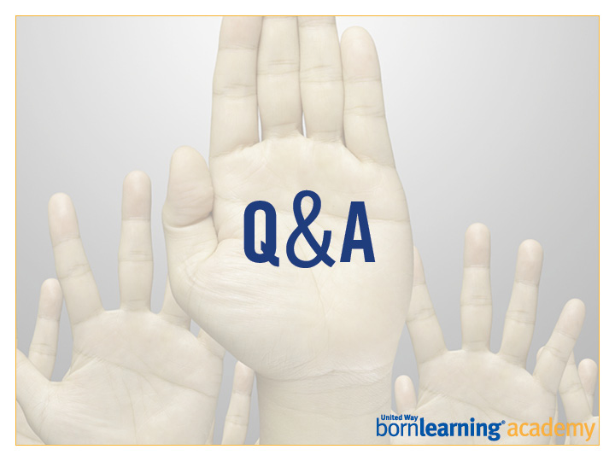

Slide 33
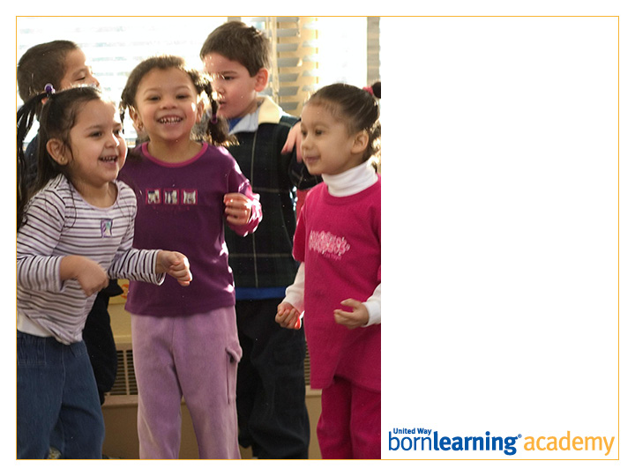
Post-Test

Slide 34
ACTIVITY
Pick up your children from __ and break out into groups.
Each breakout meets for ten minutes. Directions will be given there.

Slide 35
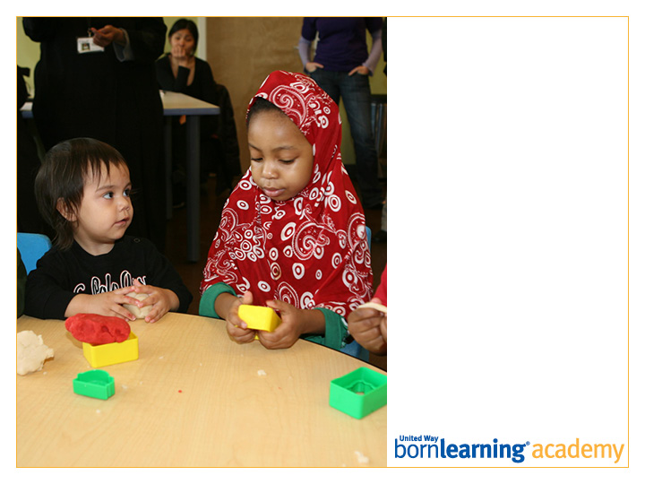
Thank you!
Workshop 4:
DATE AND TIME

Slide 36
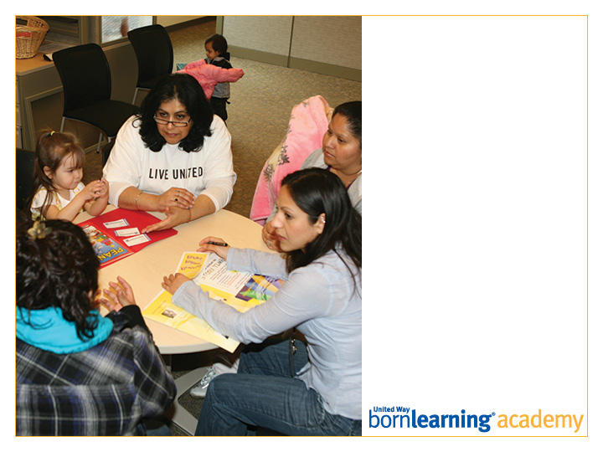
SAMPLE HEADLINE
SAMPLE

Slide 37
SAMPLE

Slide 38
SAMPLE
SAMPLE
SAMPLE

Slide 39

SAMPLE

