Slide 1

United Way
Born Learning Academy
Workshop 2

Slide 2
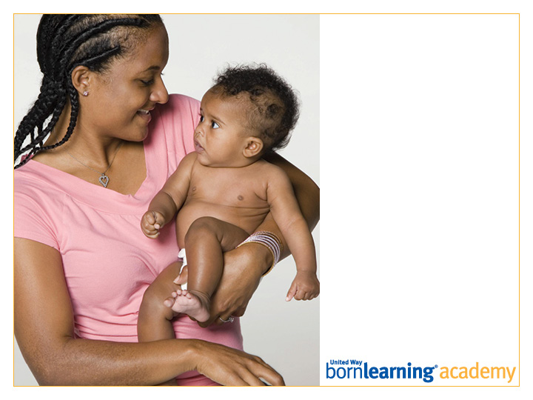
Pre-Test

Slide 3
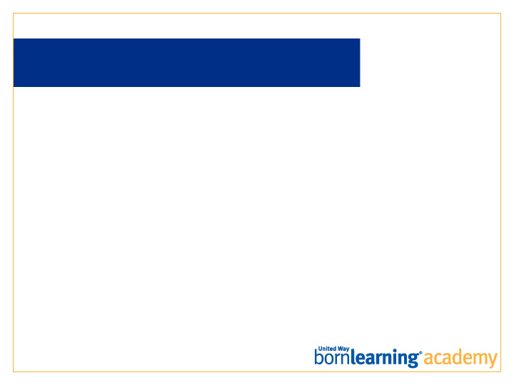
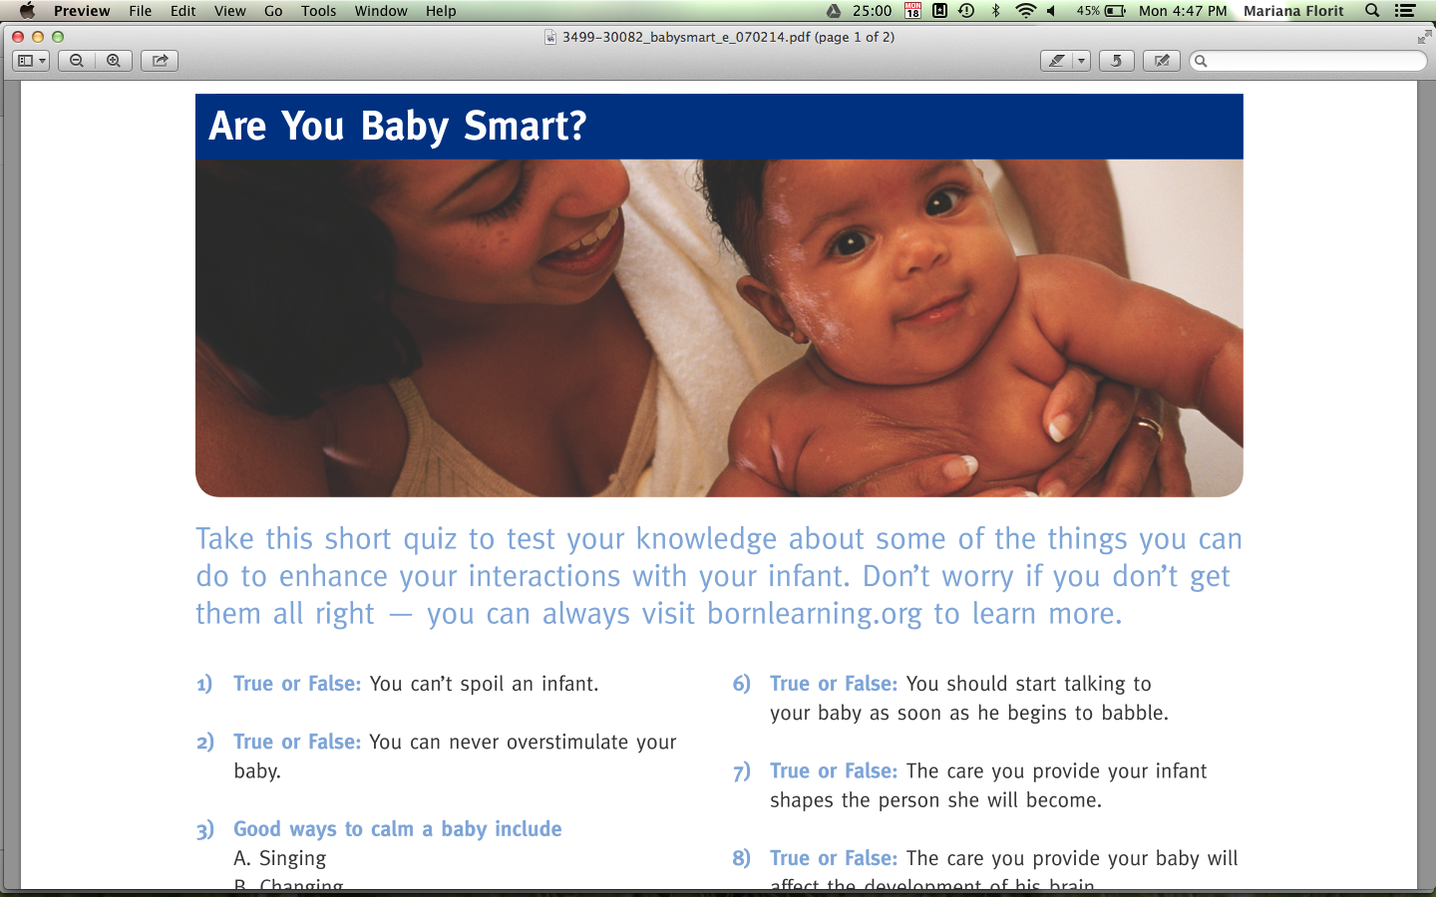
QUIZ: ARE YOU BABY SMART?
You may do the quiz with a partner. Discuss with the people around you when finished. We will discuss as a whole group.

Slide 4



What can you do to better understand your child’s cues?

Slide 5
UNDERSTANDING A CHILD’S CUES
Pay attention to their behaviors and body language.
Listen to them.
Think about what might be different in your day’s routine to cause changes in behavior.

Slide 6

BUILDING RELATIONSHIPS
Relationships are at the heart of learning. They are the foundation.
Children who connect with adults are more secure.
Children who feel safe will take risks and explore.

Slide 8

HOW DO YOU CONENCT WITH
YOUR CHILD?
Listen to your child.
Play games.
Sing with them.

Slide 9
HOW DOES THIS HELP
SCHOOL READINESS?
Children’s social/emotional development is key!
Positive relationships provide a model for how to get along with others and solve problems, supporting social development.
Understanding and talking about feelings supports emotional development.
Children learn to control themselves and change their behavior.
They need to learn to express themselves and give names to their feelings.

Slide 10
CHILDCARE CHECKLIST
Choose a safe, nurturing setting that meets children’s social and emotional needs.
Adult to Child Ratio: The fewer children for each adult, the better for your child.
Group Size: The smaller the group, the better.
Qualifications: Your child is likely to learn more with an educated staff.

Slide 11
CHILDCARE CHECKLIST
Staff Turnover: Your child needs to have a relationship with his teacher, and feel safe in his environment.
Accreditation/Quality Rating: This is an indicator of quality.

Slide 12

HOMEWORK
Read to your child before bed!

Slide 13


Slide 14

Post-Test

Slide 15
ACTIVITY
Pick up your children from __ and break out into groups.
Each breakout meets for ten minutes. Directions will be given there.

Slide 16
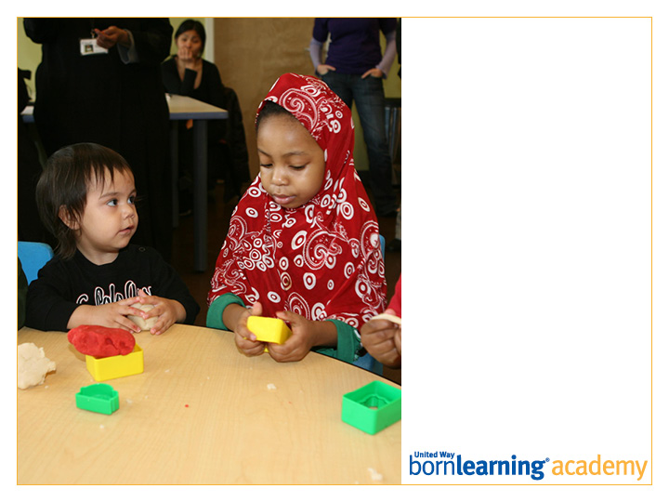
Thank you!
Workshop 3:
DATE AND TIME

Slide 17
SECTION HEADLINE
Deck style

Slide 18
SECTION HEADLINE
Deck style

Slide 19

SECTION HEADLINE
Deck style

Slide 20
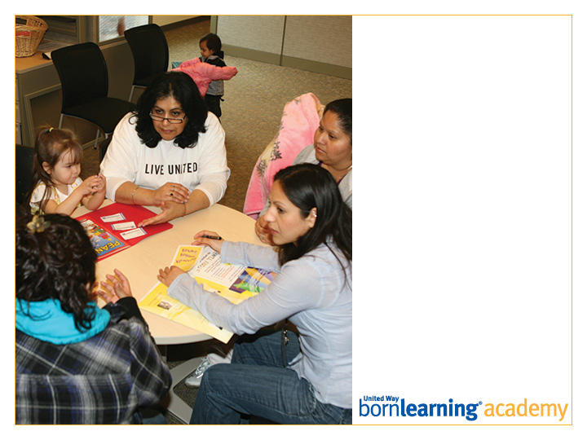
SECTION HEADLINE
Deck style

Slide 21
SLIDE TITLE GOES HERE
Bullet copy style
Bullet copy style
Bullet copy style
Bullet copy style

Slide 22
Open Copy/Layout Slide

