Slide 1
Literacy Kits A Hands-On Activity

Slide 2

The Problem
82%
of low-income 4th graders are not proficient in reading
Kids who don’t read proficiently by the end of 3rd grade are
4X
more likely to leave school without a diploma

Slide 3

The Solution
The single most significant factor in a child’s early educational success is an introduction to books and being read to at home before starting school
National Commission on Reading
The most successful way to improve the reading achievement of low-income children is to increase their access to print
Council for a Strong America
Notes:
http://www.ferstfoundation.org/resources/fifty-top-literacy-statistics

Slide 4
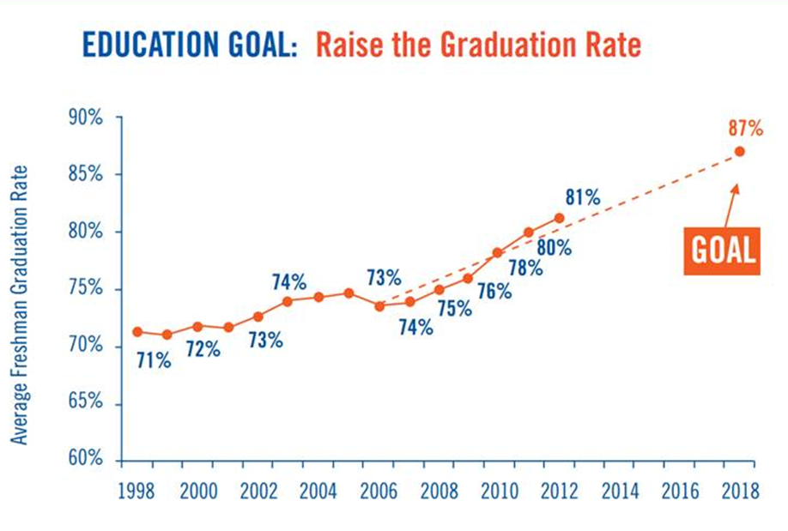
Your Impact
[Your Organization]

Slide 5
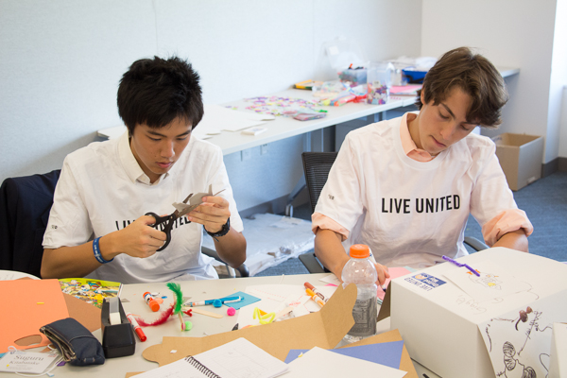
Literacy Kits
Book + Prop/Game/Puzzle
Donated to classrooms, community programs, individual children
Partners donate kits and provide volunteers
Tool for local United Ways!

Slide 6
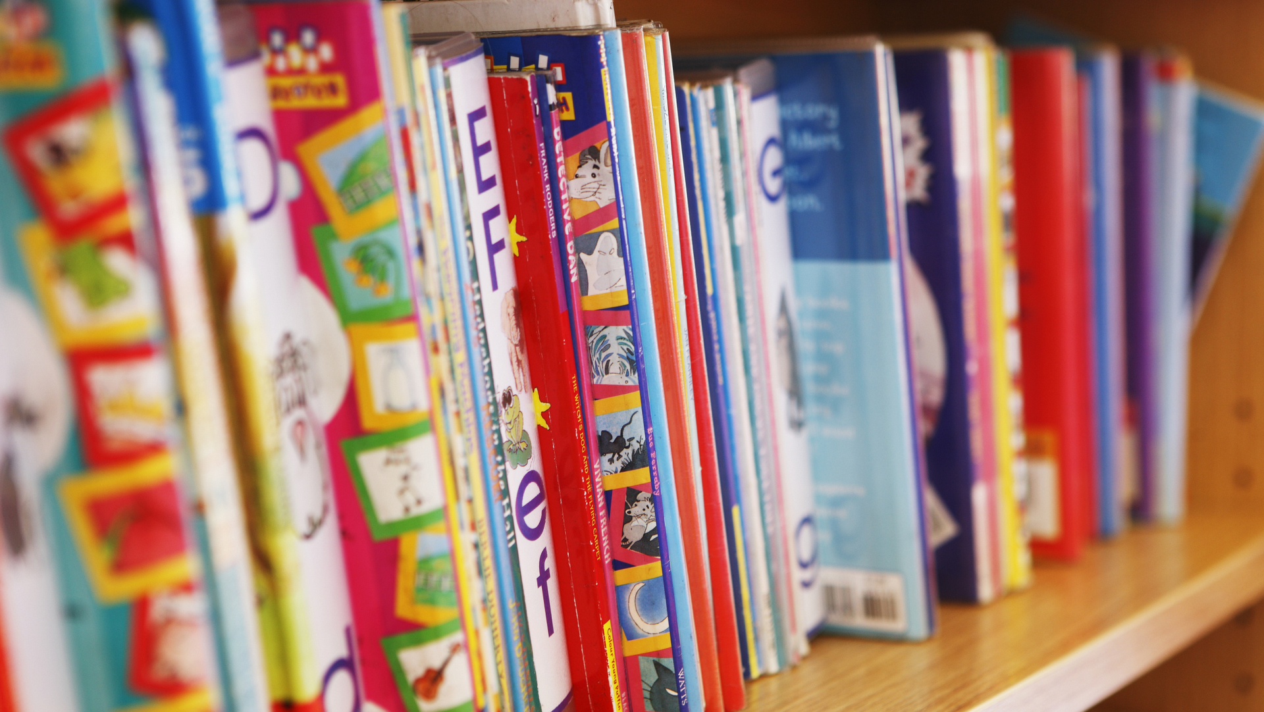
Instructions
Getting Started:
Pick a book
Read the book at your table then follow the kit-making instructions
If there’s time:
Complete another kit
Decorate the kit container!
Wrapping up:
Ensure each kit has all supplies
Clean up!

Slide 7
You made a difference. Thank you!

